Slide 1
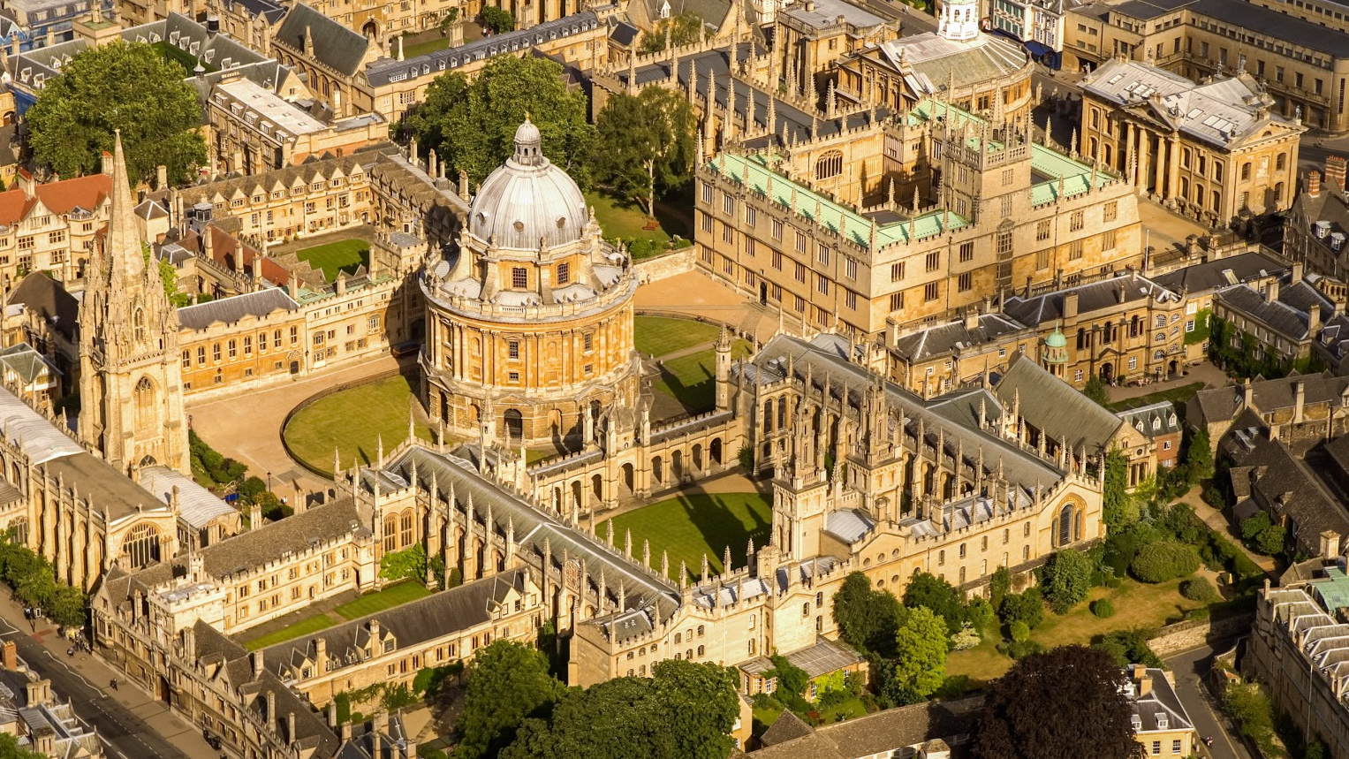
Oxford, England
By roman belykh

Slide 2
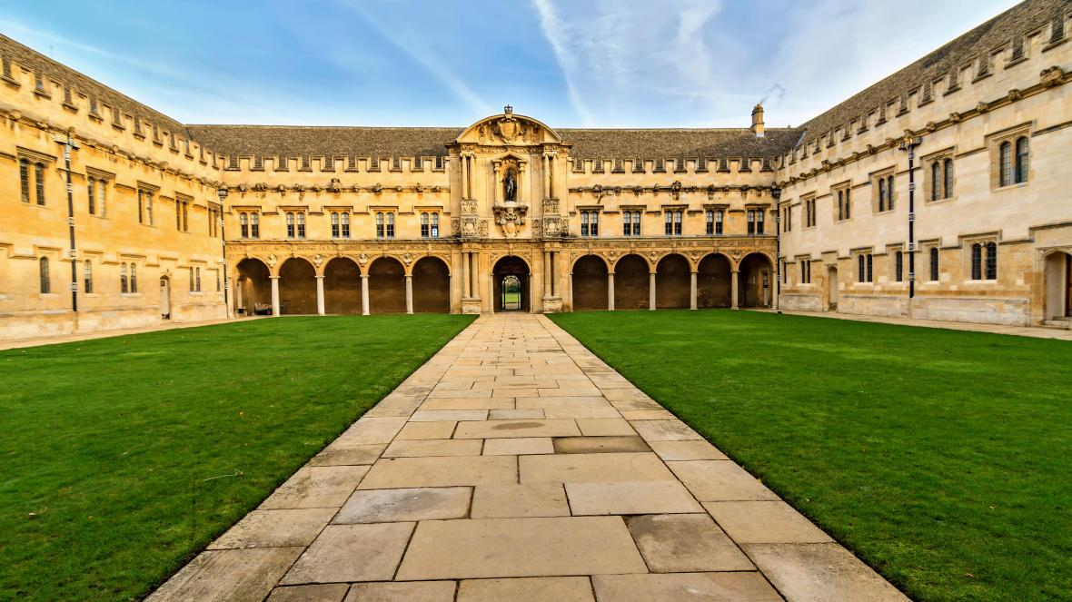
Oxford University is one of the oldest in the world.
The first colleges of Oxford were built in the 13th century.

Slide 3
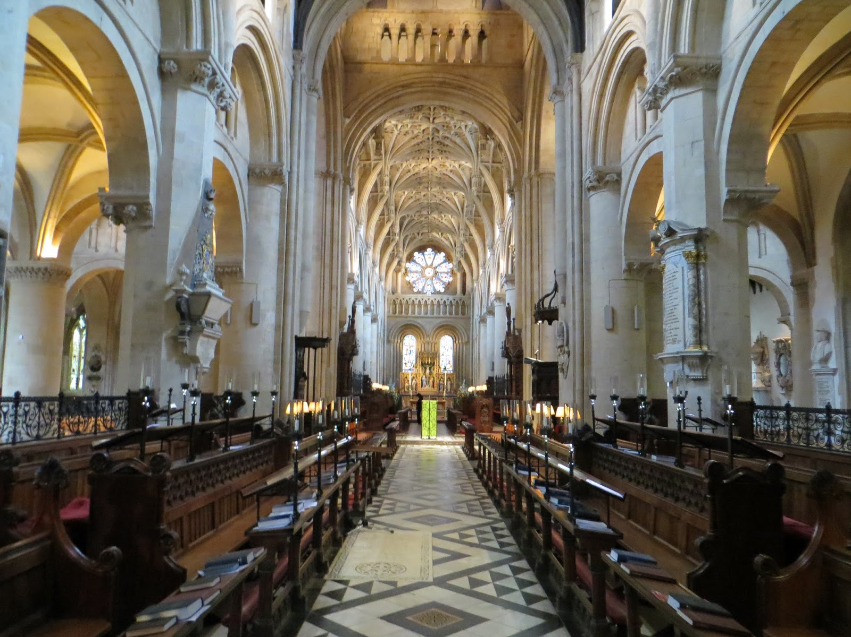
The Legend of Frideswide
Legend has it that Oxford was started by a beautiful and pious young princess named Frideswide. When her dream of becoming a nun was threatened by a king who wanted to marry her, Frideswide ran away to Oxford. The king followed her, but when he reached the town boundaries, he was struck blind. After begging her forgiveness and reluctantly agreeing to give her freedom from marrying him, his sight was amazingly restored. Frideswide went on to set up a nunnery on the site of what is now Christ Church cathedral. The earliest built colleges were set up around the nunnery as learning places for monastic scholars.

Slide 4
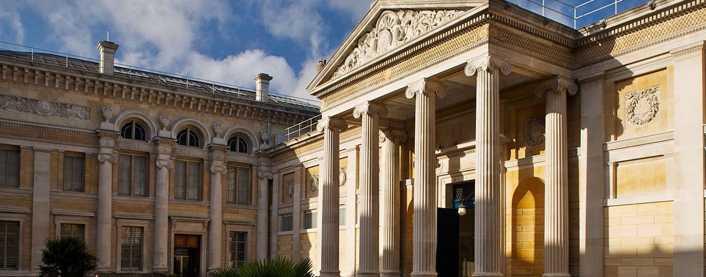
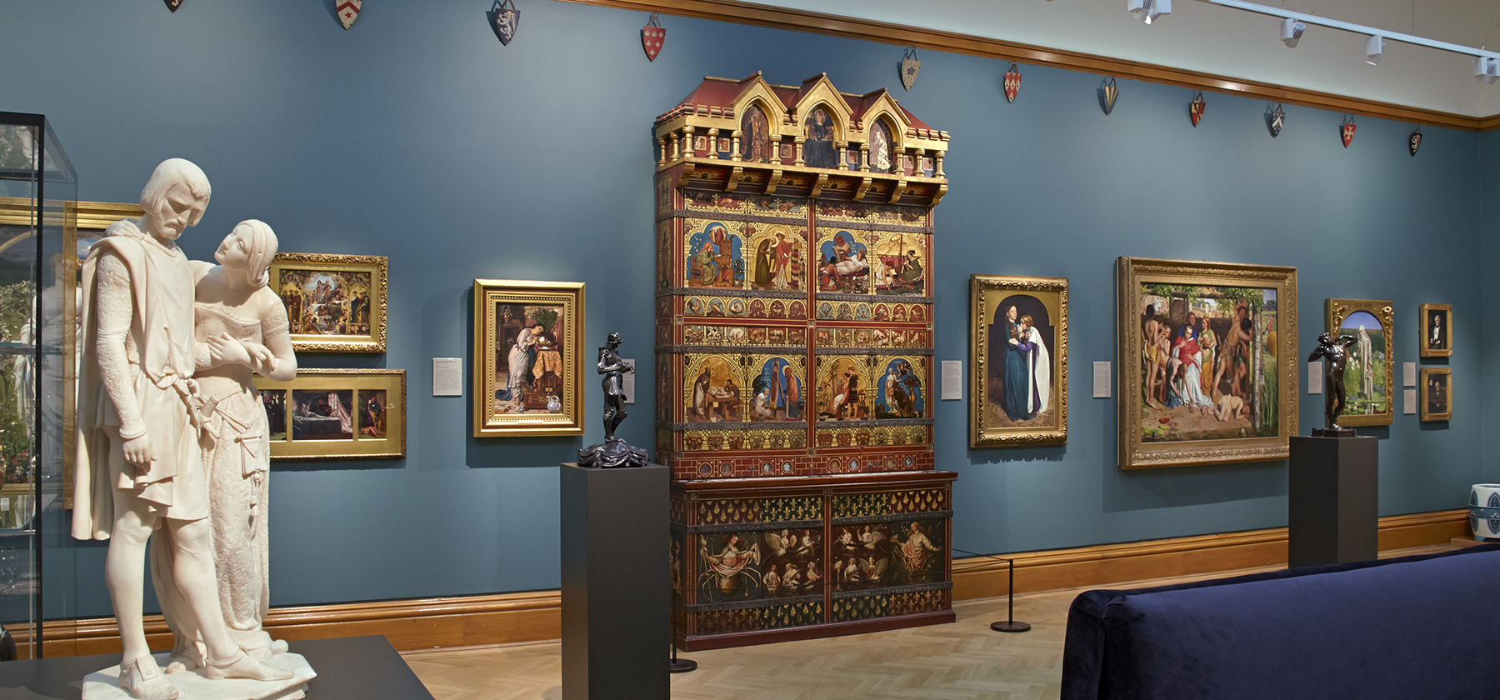
Ashmolean Museum
Oxford's Ashmolean Museum was the first museum in the world to be opened to the public when it was officially opened in 1683 according to the Guinness Book of Records.

Slide 5
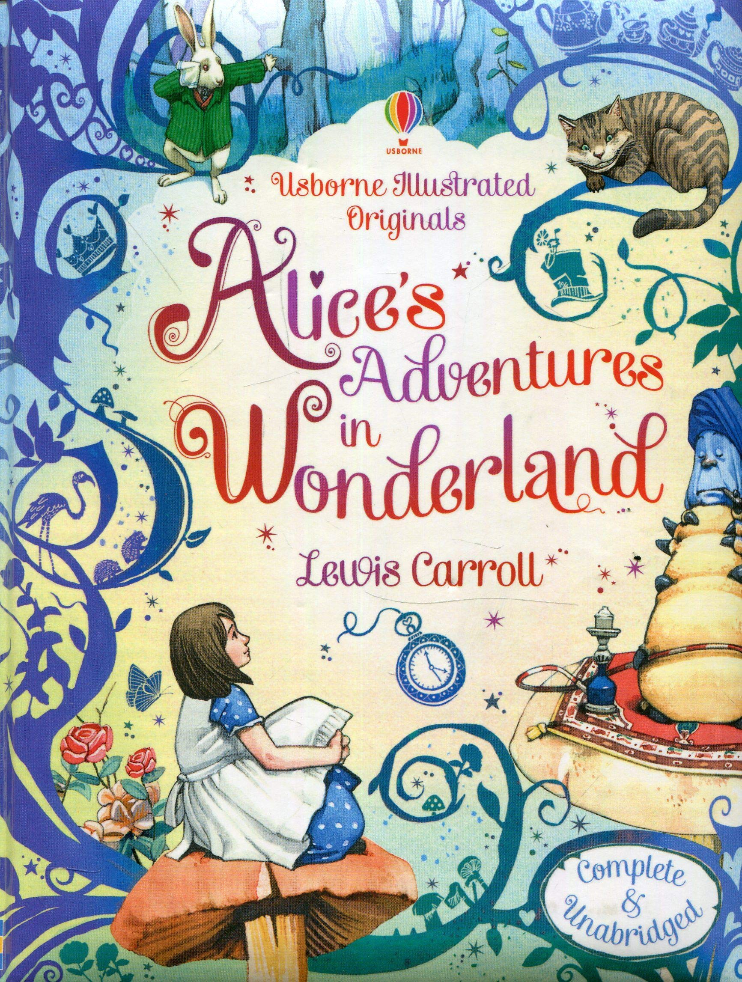
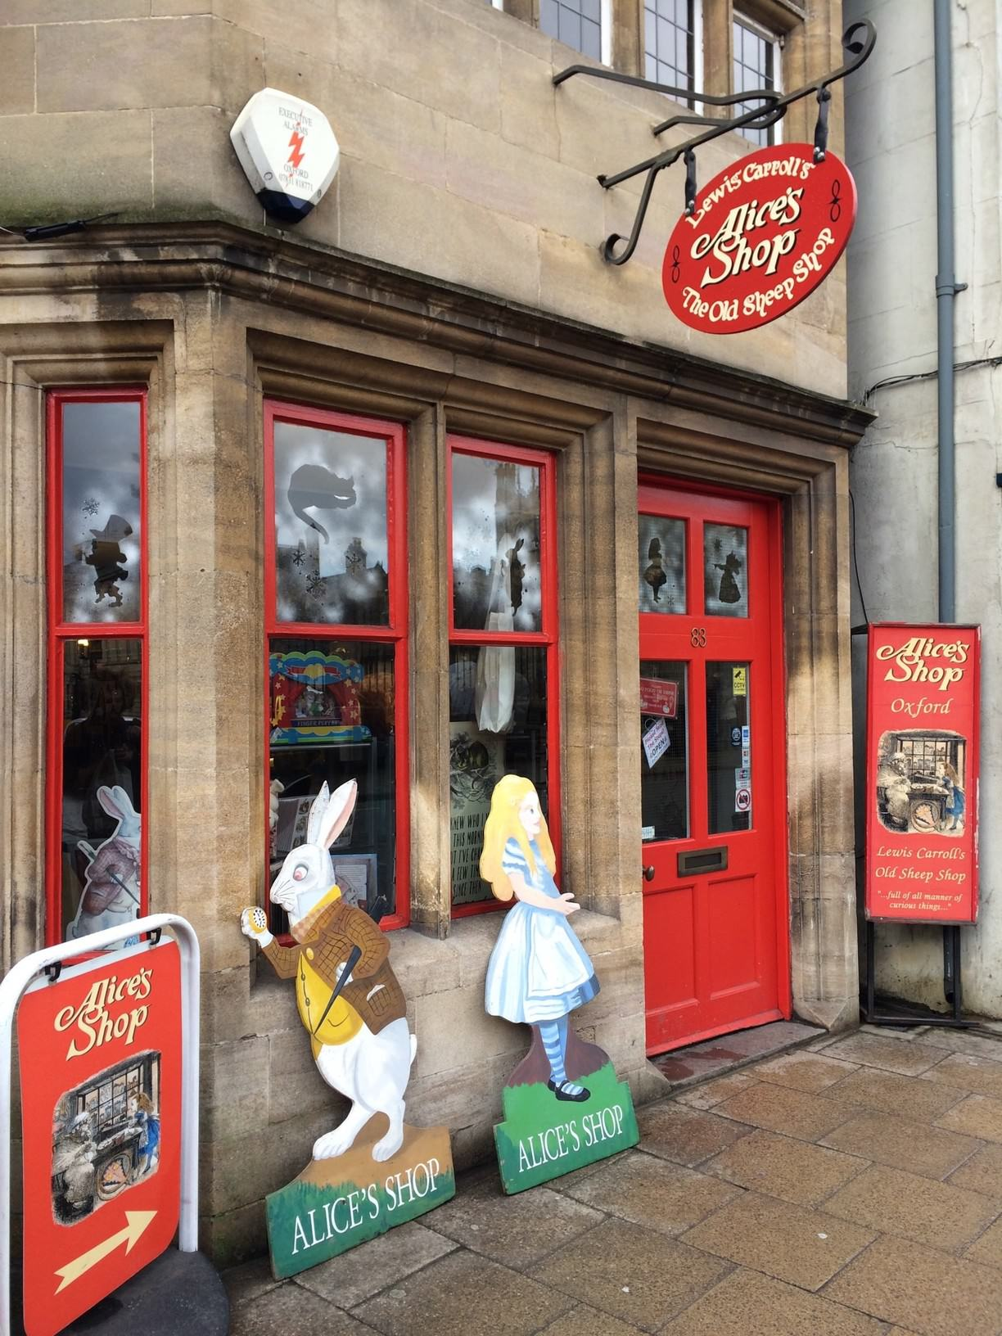
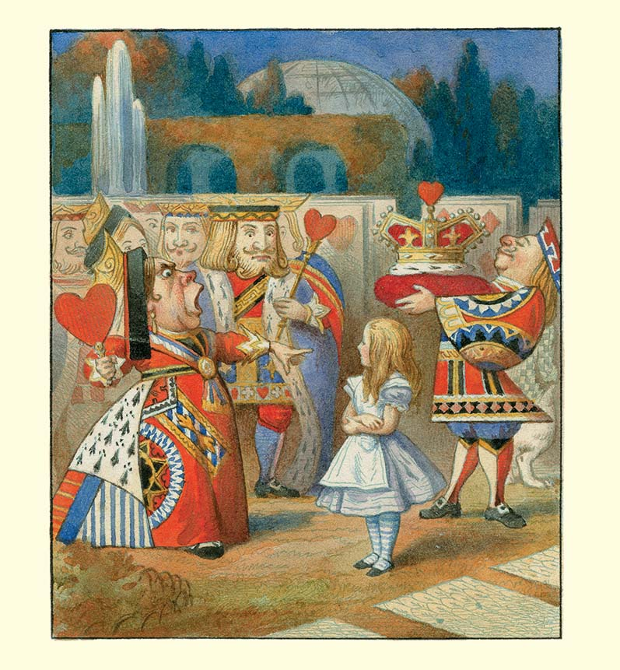
The Real Alice
Alice, from Alice in Wonderland, was a real girl named Alice Liddell. She was the daughter of the Dean at Christ Church, who was a friend of Charles Dodgson (A.K.A. Lewis Carroll), who taught at the College. Dodgson spent much time with Alice and her family, and immortalized her in his books.

Slide 6
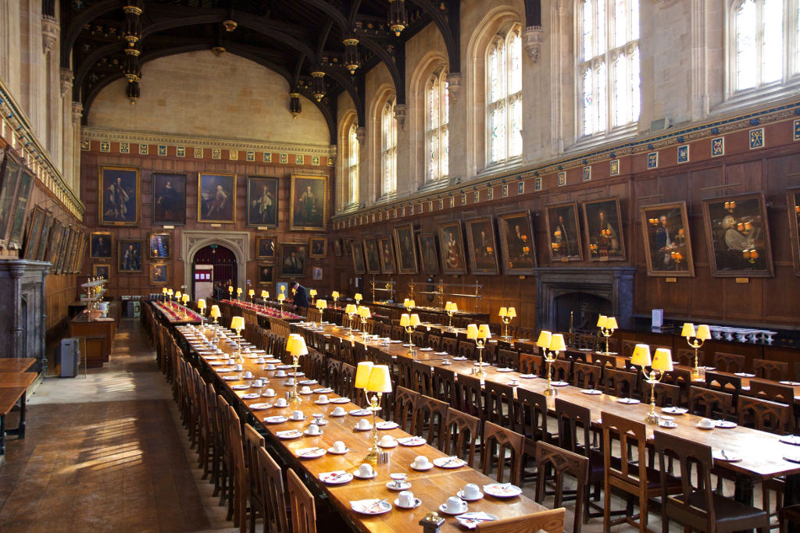
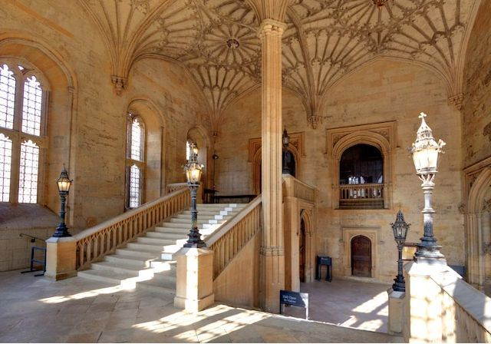
Harry was here
The Great Hall at Christ Church was used as inspiration for the Hogwarts dining hall in the Harry Potter films. The staircase leading up to the hall was actually used in several scenes in the films

Slide 7
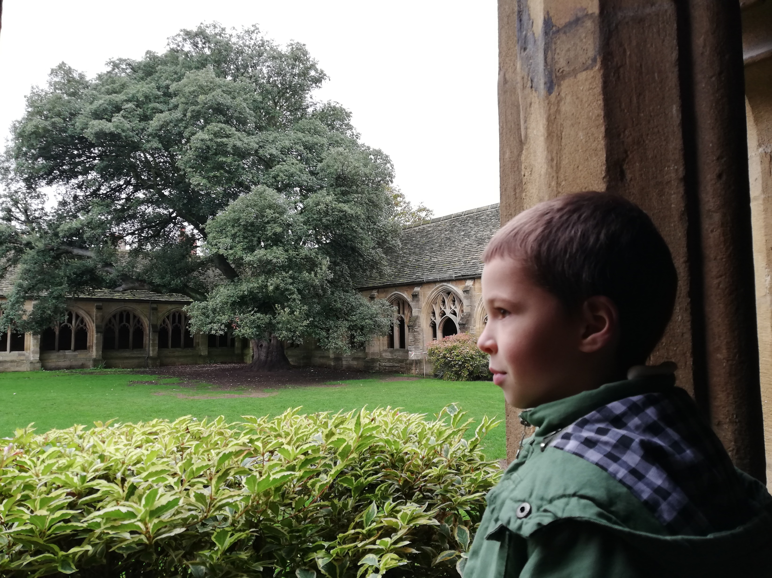
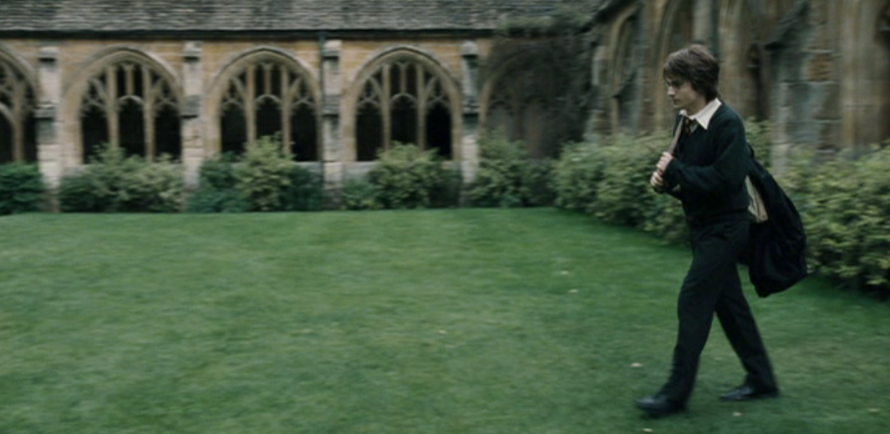
New College is another place for Harry Potter fans.

Slide 8
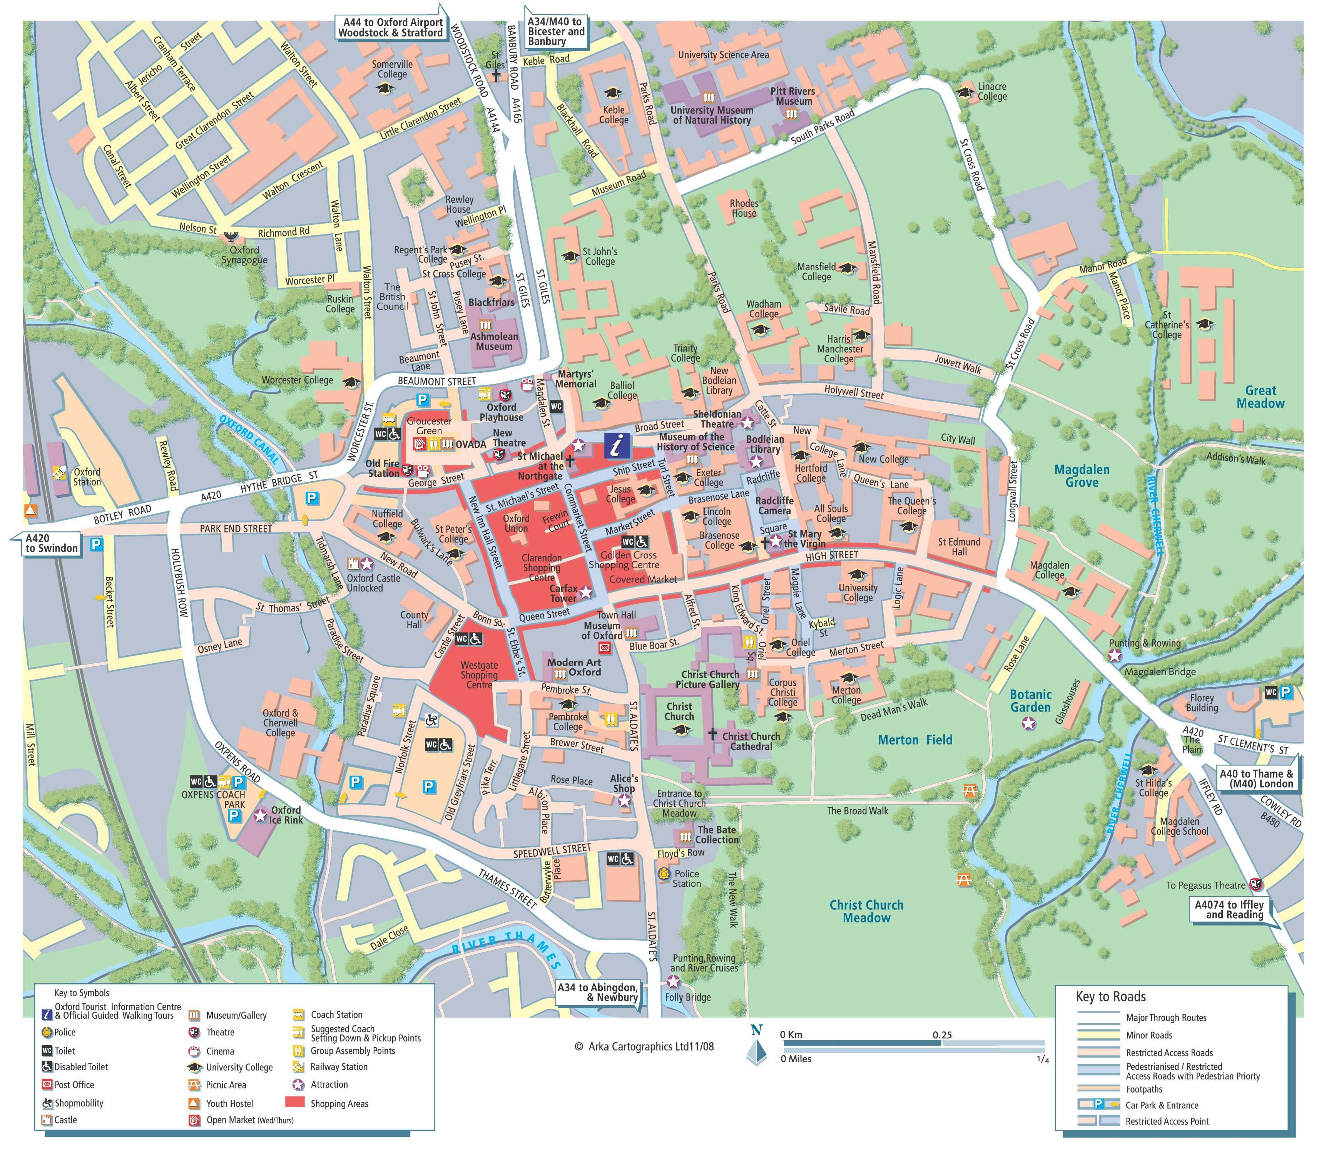
Map of Oxford

Slide 9
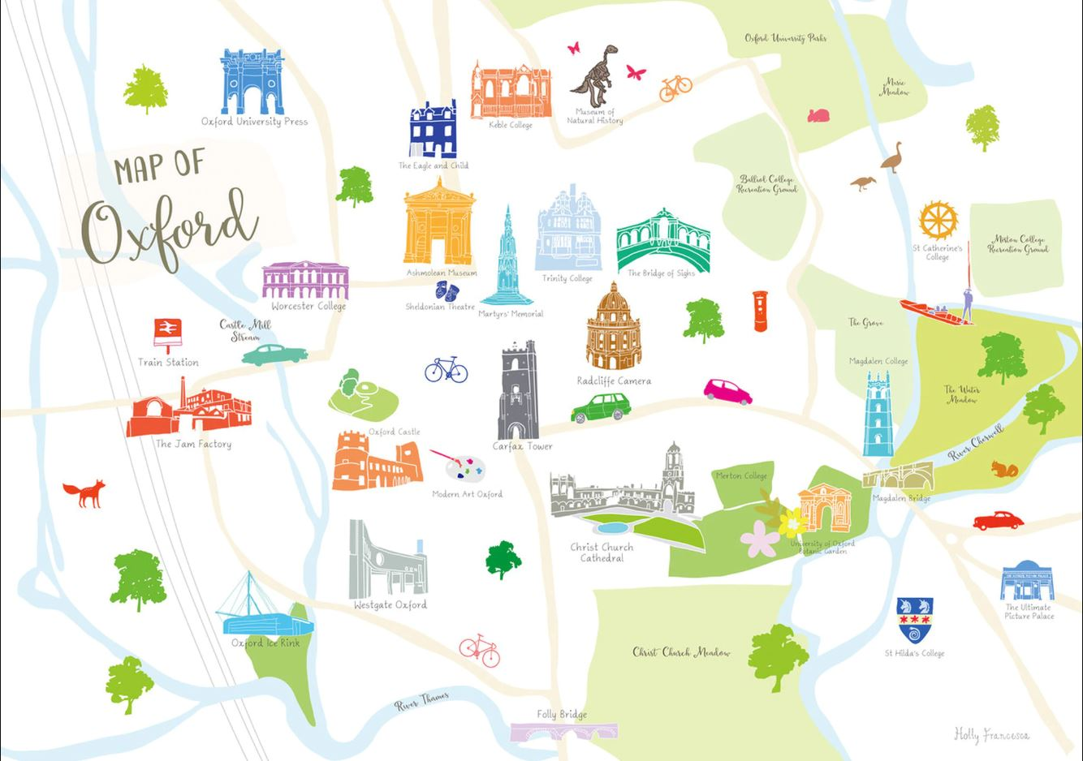

Slide 10
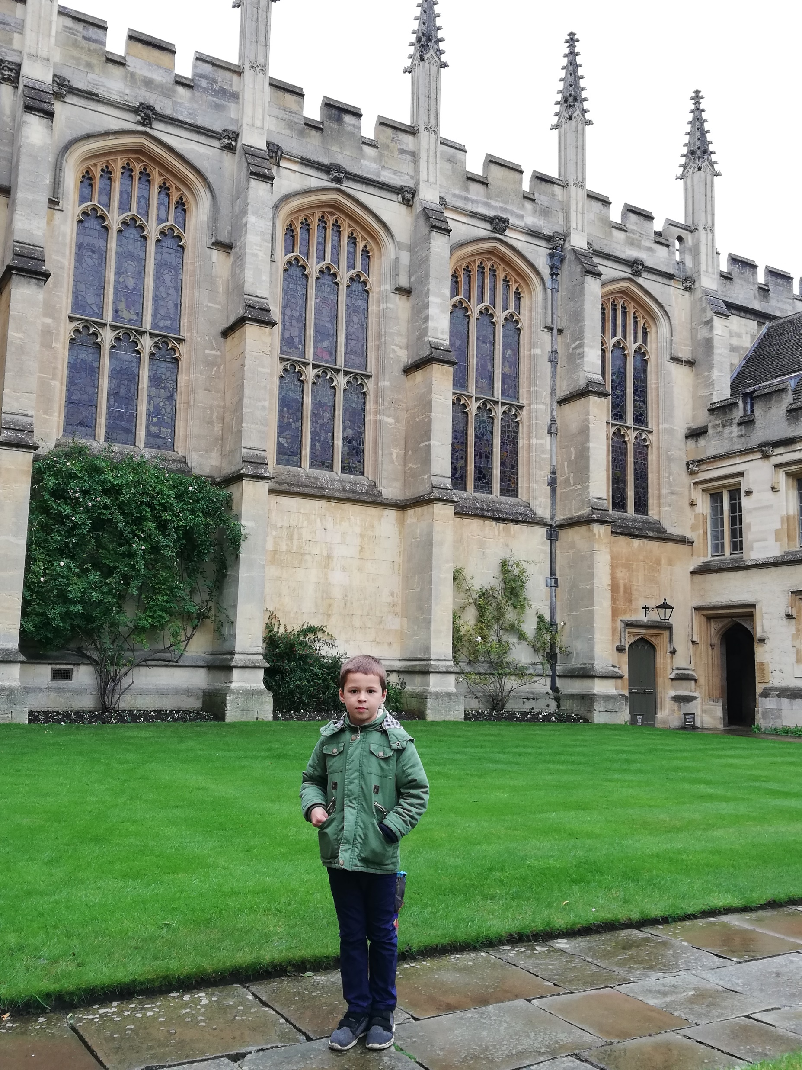
Oxford has it all. A university that dates back to the 11th century, magnificent sandstone architecture and amazing scenery all around. It’s packed with museums, libraries and historical places.
Oxford makes the perfect day trip from London – but you should spend more time there if you can. I’d suggest three days to explore the city at a leisurely pace.
I hope you enjoy your time in OXFORD as much as I did.

